Slide 1
IS 675: DEEP LEARNING FOR BUSINESS
MACHINE LEARNING ANALYSIS FOR FORMULA 1
TEAM MEMBERS:
Yesha Ajaybhai Doshi Shoaeb Nawab Shaik
Rithika Goud Pabathi Visnupiriyan Kumarraja

Slide 2

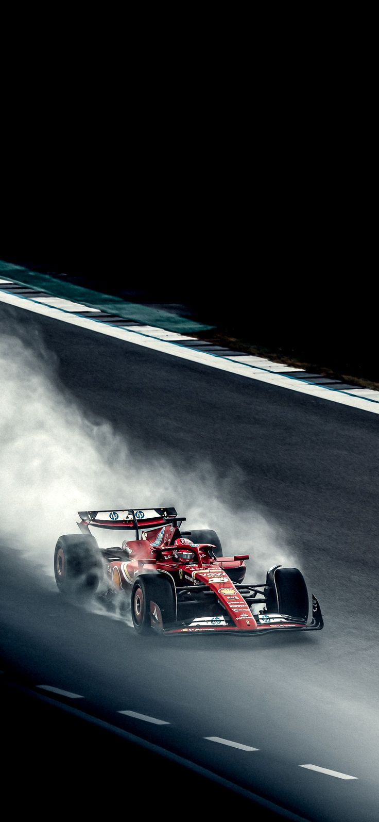
Problem Statement
In Formula 1 racing, optimizing various factors such as pit stop efficiency, lap times, and qualifying positions is critical for improving a driver’s race performance and overall championship standing.
This project seeks to analyze these aspects within historical Formula 1 data to identify actionable strategies for reducing pit stop durations and improving driver and team performance.
By examining the influence of pit stops, lap times, and race strategies on final race outcomes, this analysis aims to provide insights that can help teams enhance their competitive edge and maximize winning potential.

Slide 3
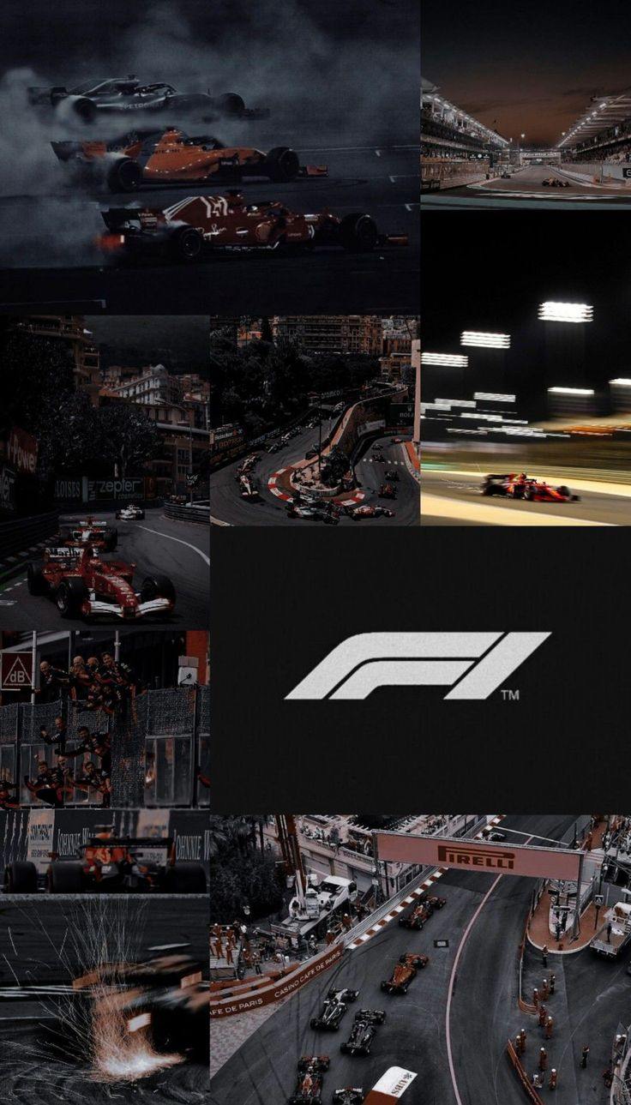
Business Understanding
OBJECTIVE
Predict performance in racing events and optimize race strategies.
The overarching goal is to leverage historical racing data to predict performance and optimize race strategies.
BUSINESS QUESTIONS
Performance Prediction: What factors most significantly predict a driver’s performance or likelihood of winning?
Strategy Optimization: How can pit-stop strategies be adjusted to maximize race efficiency?
Team Dynamics: What role do constructors (teams) play in influencing outcomes?
Event Insights: How do specific circuits or historical race conditions affect outcomes?
SUCCESS METRICS
Predictive Accuracy: Models should achieve at least 80% accuracy in predicting race outcomes.
Strategic Value: Teams adopting the insights should demonstrate measurable improvements.
Actionability: The findings must be interpretable and actionable by non-technical stakeholders.

Slide 4

Database Overview
Circuits - Information about the racing circuits used in various events.
Constructor Results - Detailed results of constructors (teams) in individual races.
Constructor Standings - Championship standings of constructors for each season.
Constructors - General information about constructors (teams).
Driver Standings - Season-wise standings of drivers in the championship.
Drivers - Information about the drivers participating in races.
Lap Times - Recorded lap times for each driver in individual races.
Pit Stops - Data on pit stops performed during races.
Qualifying - Qualifying results determining the starting positions for races.
Races - Details of each race in the dataset.
Results - Comprehensive results of each race, including positions and outcomes.
Seasons - Information about Formula 1 seasons.
Sprint Results - Results from sprint races (shorter race formats).
Status - Driver statuses during races (e.g., finished, retired, crash).

Slide 5
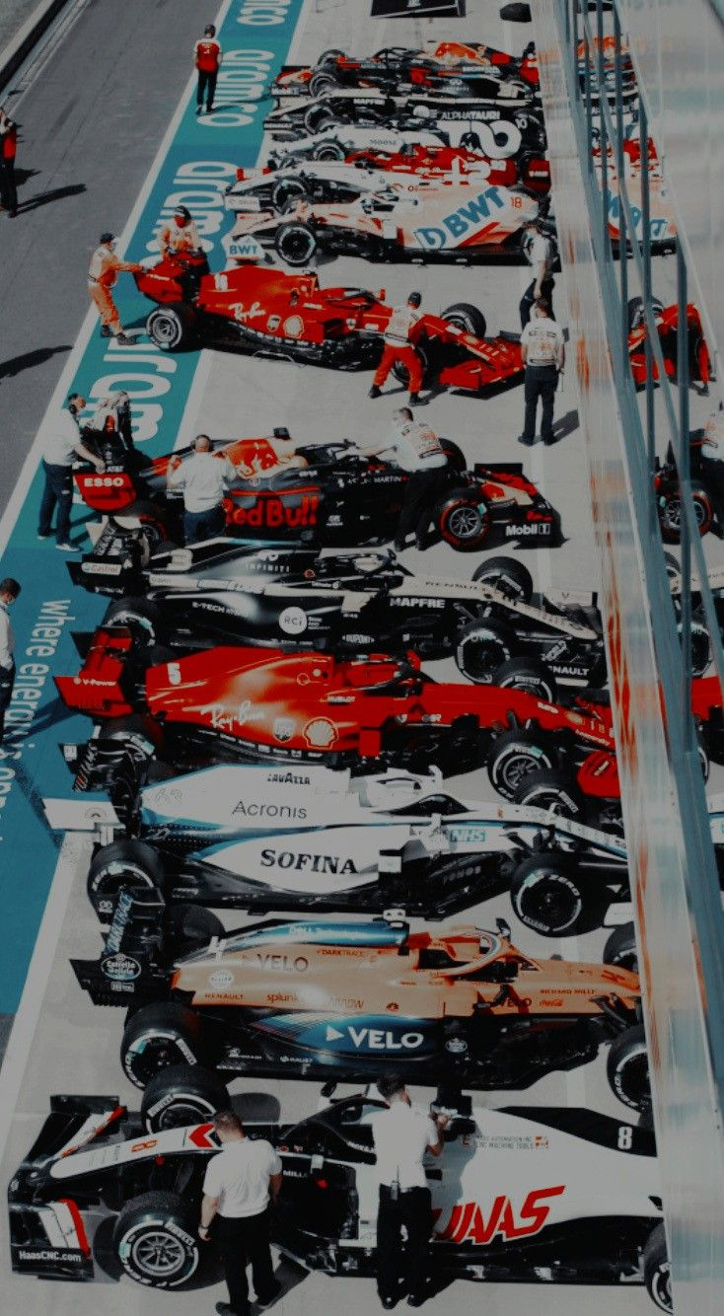
Data Preparation
Dataset Name | Key Fields | Relevance
Circuits | Circuit name, location, country, and geographic details. | Analyze how circuit characteristics impact driver and constructor performance.
Constructor Results | Constructor ID, race ID, and points scored. | Evaluate team performance in specific events and seasons.
Constructor Standings | Constructor rank, points, and number of wins. | Track progress and competition among constructors.
Constructors | Constructor name, nationality, and reference ID. | Contextualize constructor performance and heritage.
Driver Standings | Driver rank, points, and wins. | Analyze individual driver performance trends over time.
Drivers | Name, nationality, and career details. | Provide demographic and career data for performance analysis.
Lap Times | Race ID, driver ID, lap number, and time. | Understand performance consistency and patterns during races.
Pit Stops | Time spent in pit stops, number of stops, and race ID. | Evaluate race strategies and efficiency.
Qualifying | Driver position, times, and session details. | Predict race outcomes based on qualifying performance.
Races | Race date, name, circuit ID, and season year. | Form the backbone of analysis by linking other datasets.
Results | Position order, points, and status. | Primary dataset for outcome prediction and performance evaluation.
Seasons | Year, championship details, and associated races. | Provides a temporal framework for analysis.
Sprint Results | Driver positions and points. | Adds granularity to performance analysis in varied race formats.
Status | Status ID, description. | Essential for creating incident-based metrics and predicting risks.
Steps Taken:
Merged multiple datasets, e.g., constructors with standings, races with results.
Converted categorical columns for efficient processing (astype('category')).
Handled missing values using imputation strategies:
Mean for numeric columns.
Most frequent for categorical data.
Resulting Datasets:
Prepared datasets for numerical and categorical analysis.
Filtered historical data for specific events (e.g., British Grand Prix).
Feature Engineering:
Created binary target (e.g., incident occurrence or win prediction).
Calculated pit stop percentage relative to total race time.

Slide 6
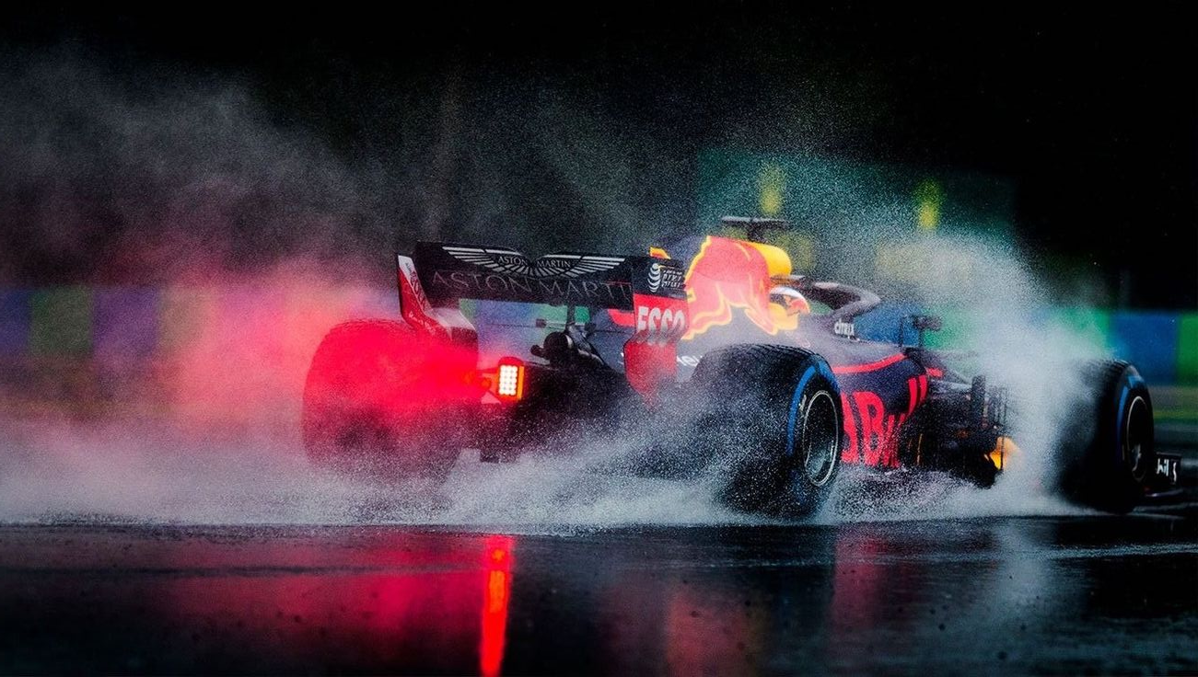
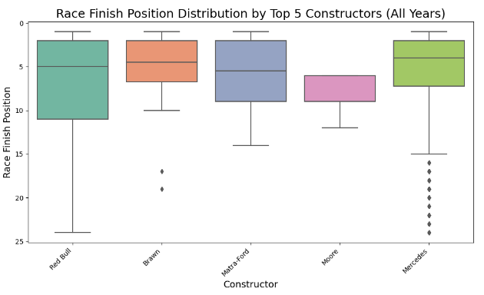
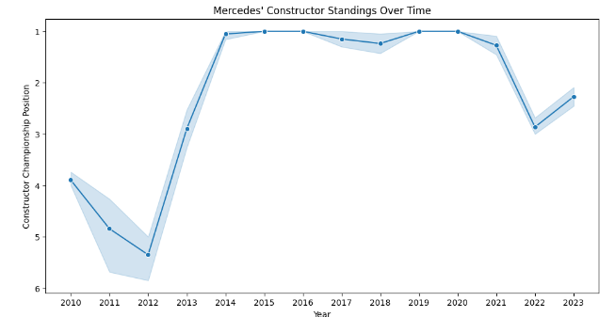
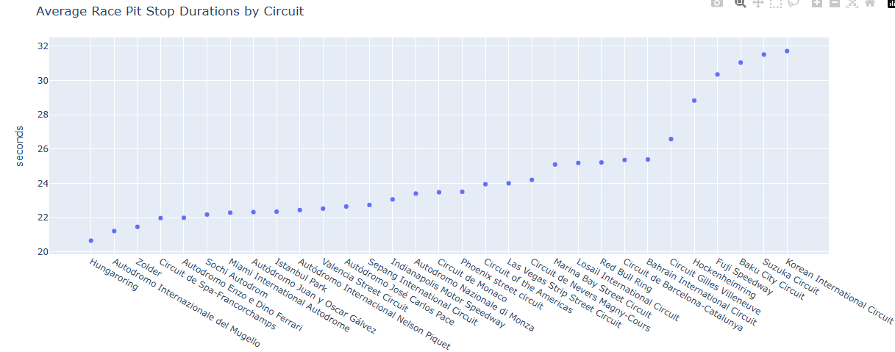
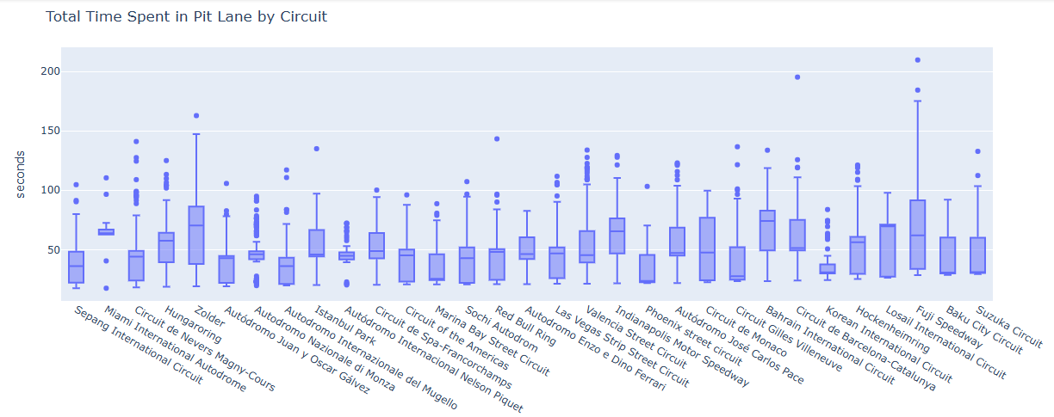
Data Visualization
BOXPOT ANALYSIS – RACE FINFISH POSITIION
LINE GRAPH – FOR SINGLE CONSTRUCTOR (TEAM)
Our data visualization strategy is to employ a variety of techniques to bring Formula 1 data to life. From interactive driver comparison tools to detailed track analysis heat maps and dynamic championship progression graphs, these visualizations will offer intuitive and insightful ways to explore the complex world of Formula 1 racing.
LINE GRAPH ANALYSIS
BOXPOT ANALYSIS

Slide 7
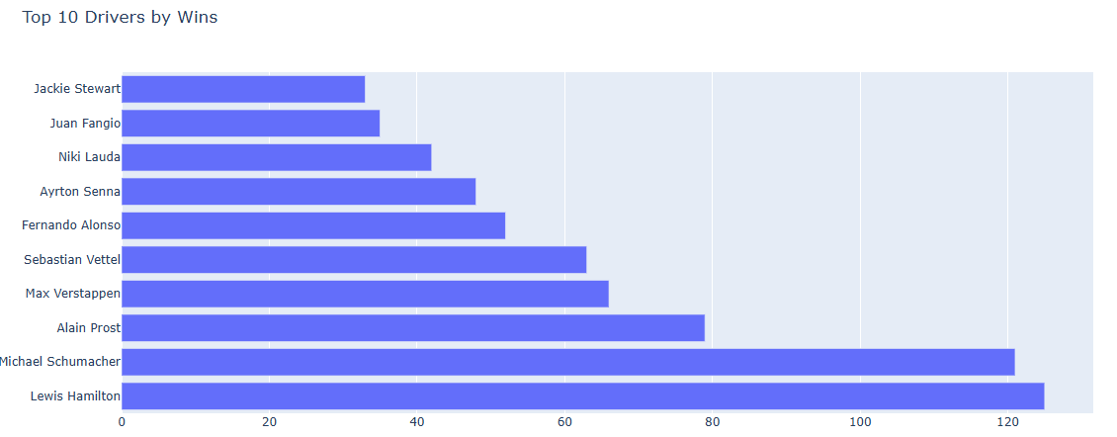
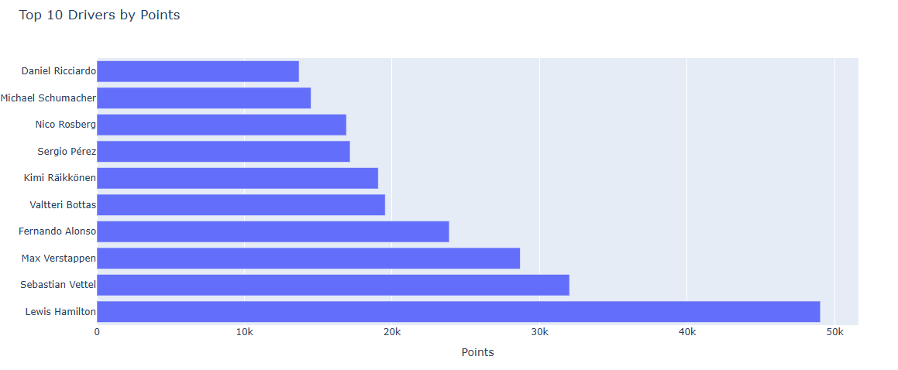
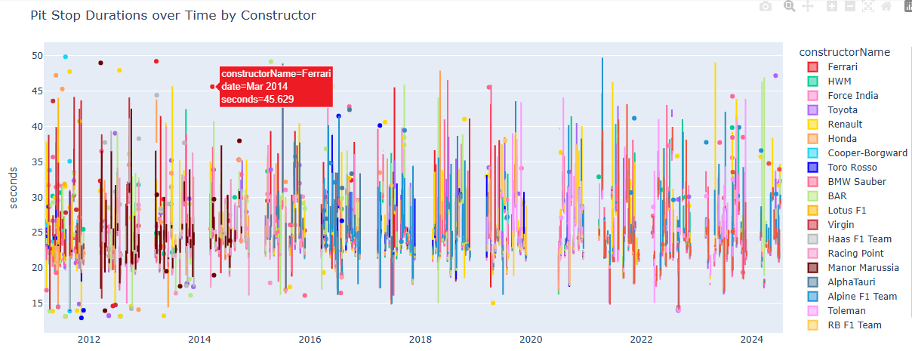
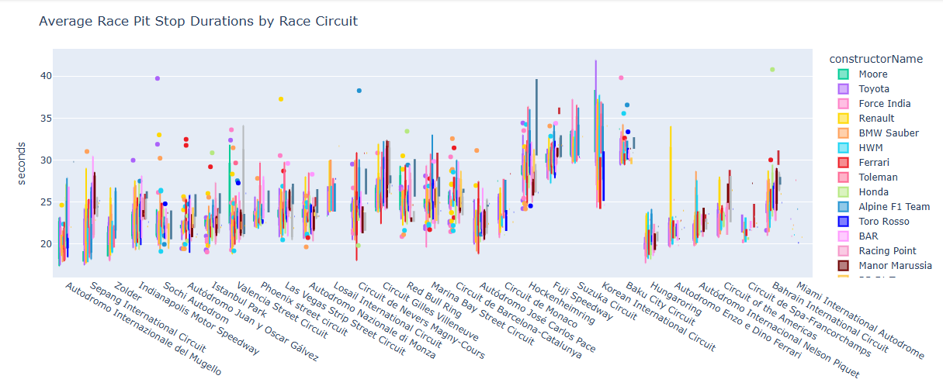
Data Visualization

Slide 8
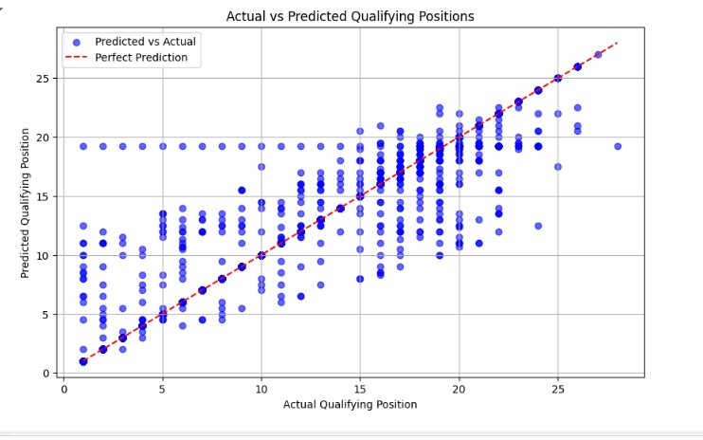
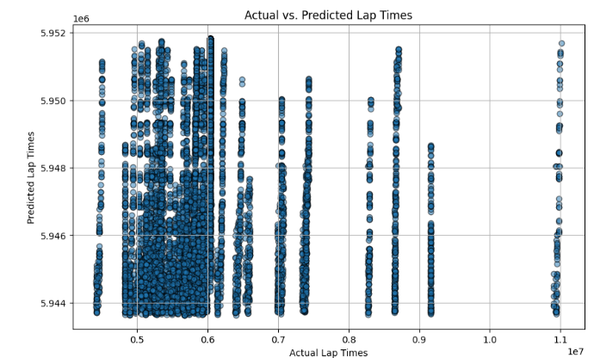
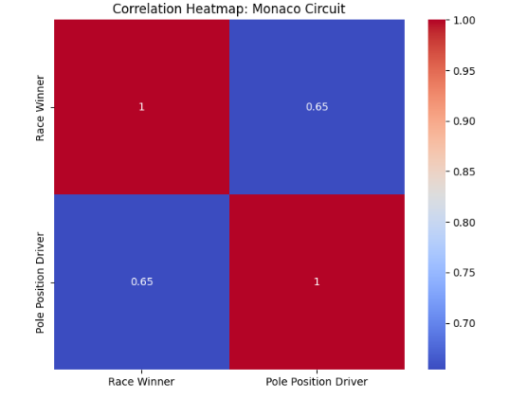
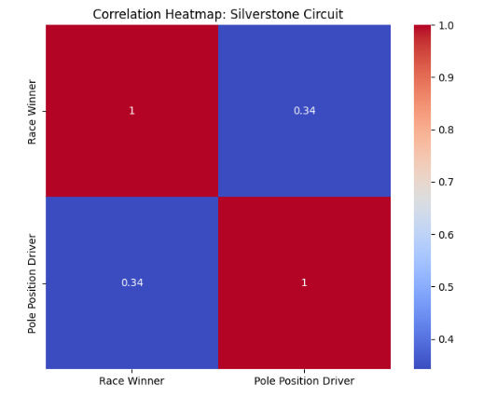
Data Visualization
PIT STOP IMPACT ANALYSIS
LAP TIME PREDICTION
CORRELATION HEATMAP:
Heatmaps demonstrate the relationship between starting grid positions (like pole position) and final race results. For example, Monaco shows a high correlation between pole position and winning due to the circuit's limited overtaking opportunities.

Slide 9

Modeling
Objectives of Modeling
Predict race outcomes (e.g., driver or constructor performance).
Simulate and optimize pit-stop strategies for efficiency.
Evaluate patterns and insights from qualifying and lap times to aid race strategy.
Data Preparation for Modeling
Handled missing values using:
Mean imputation for numerical fields.
Most frequent category imputation for categorical fields.
Ensured all numeric columns were treated appropriately (astype(float)).
Applied one-hot encoding for categorical variables (e.g., driver nationality).
TARGET VARIABLES
Primary Target Variable
Race Position (final race standing)
Secondary Target Variable
Pit Stop Duration

Slide 10
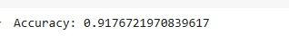
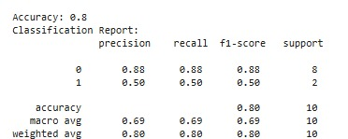
Modeling
1
Random Forest Classifier
2
Ridge Regression
3
Support Vector
Regression (SVR)
Purpose: Predict race winners and identify factors contributing to victory.
Implementation Steps:
Used Random Forest Classifier with 100 estimators for training.
Split data into 70% training and 30% test sets.
Metrics: Evaluated using accuracy (achieved ~80%) and classification reports.
Outcome: Identified key predictors like qualifying position and constructor performance.
Used to predict the impact of pit stops on race positions, focusing on numerical outcomes like position changes.
Used to predict lap times, incorporating scaled features for more accurate predictions.
4
Decision Tree Regressor:
Employed for predicting qualifying positions based on session times (e.g., Q1, Q2, Q3).

Slide 11
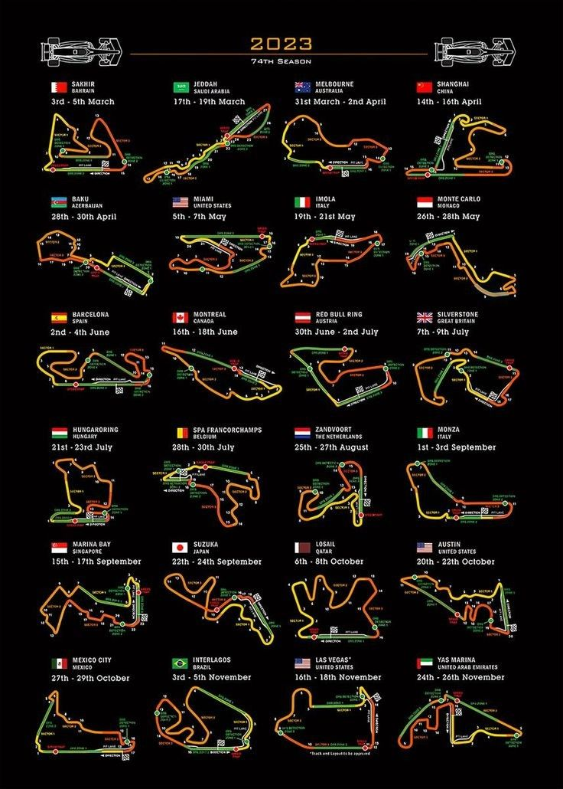
Evaluation
FINDINGS:
Random Forest effectively classifies incidents with strong metrics in classification reports.
Ridge Regression and SVR reveal important relationships between lap times, pit stops, and race positions.
Decision Tree Regressor provides quick insights into qualifying results.
MODEL OUTPUTS:
Predictions of winners for upcoming races.
Strategy recommendations based on simulation outputs.
LIMITATIONS:
Dependency on historical data.
Assumptions in simulation models may not capture all real-world factors.

Slide 12
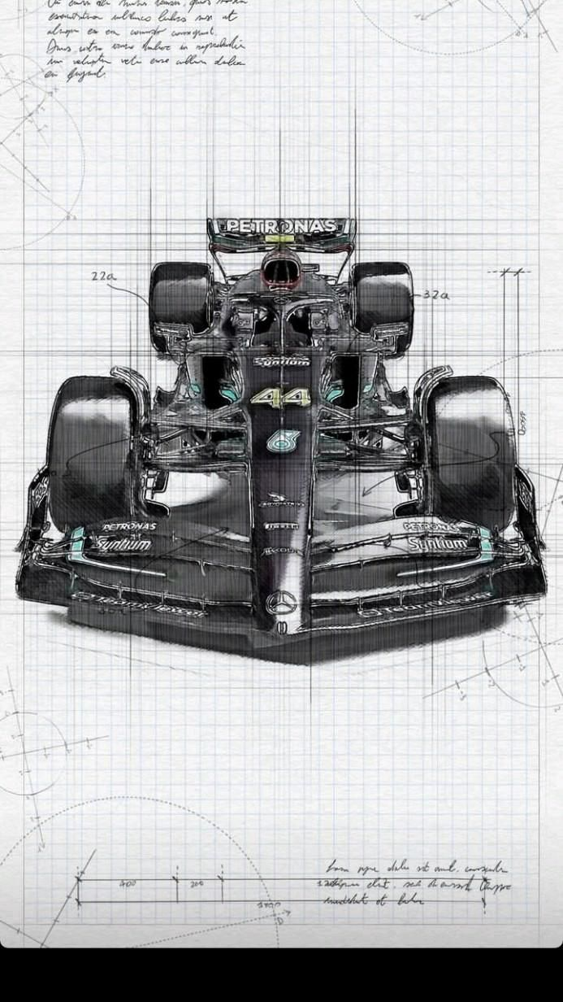
Results and Findings
Drivers with the best qualifying positions (e.g., Verstappen, Hamilton) are more likely to secure podium finishes.
Lewis Hamilton’s career demonstrates unparalleled consistency, often finishing within the top 3.
Mercedes and Red Bull maintain dominance, with a clear upward trajectory post-2014.
Findings from Visualizations:
Constructors with consistent strategies (e.g., Mercedes) outperform rivals in terms of standings and race results.
Pit stop efficiency correlates strongly with finishing positions.
Random Forest classification achieves strong predictive performance for podium finishes.
Data-Driven Insights:

Slide 13




Deployment
Optimized Pit Stop Strategies
Improved Starting Grid Strategy
Enhanced Lap Time Consistency
Competitive Edge for Teams
Insights into reducing pit stop times across circuits and improving crew efficiency to minimize race time losses.
Analyzing lap times and pit stop timings can lead to more consistent performance throughout the race, minimizing the risk of losing positions.
By combining these insights, F1 teams can improve both individual driver performance and overall constructor standings, contributing to a stronger competitive position.
Understanding circuit-specific starting advantages can help teams strategize qualifying sessions, especially at circuits where pole position is crucial.
As we conclude our Machine learning journey through the world of Formula 1, with this significant outcomes we could reshape how the sport is understood and analyzed.
From enhancing race strategies to uncovering hidden patterns in performance data, our project aims to push the boundaries of what's possible in motorsport analytics. The insights gained may not only benefit teams and drivers but also enrich the fan experience by providing deeper understanding of the intricate factors that determine success in Formula 1.

Slide 14
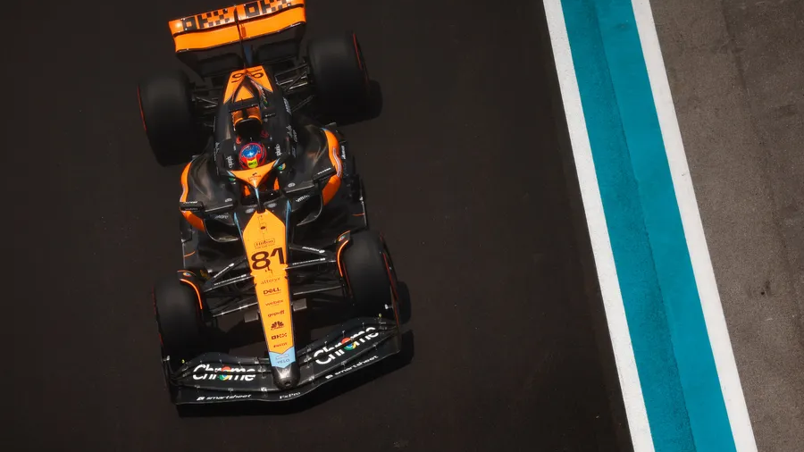
Conclusion
The project demonstrates how structured preprocessing, insightful visualizations, and robust modeling lead to meaningful conclusions about Formula 1 trends.
Multiple models demonstrated complementary insights into race dynamics.
Future work can enhance performance with hyperparameter tuning and feature engineering focused on race strategy.
THANK YOU

